Slide 1

CSE-4078 Mobile Application Development
Lectures – Week 8-9
Sara Masood

Slide 2

App of the Module

Slide 3
Geo Location
Use the package GeoLocator
geolocator | Flutter Package (pub.dev)
dependencies:
geolocator: ^8.0.0
import 'package:geolocator/geolocator.dart';

Slide 4
Geo location
Current location
Position position = await Geolocator.getCurrentPosition(desiredAccuracy: LocationAccuracy.high);
Last known location
Position position = await Geolocator.getLastKnownPosition();

Slide 5
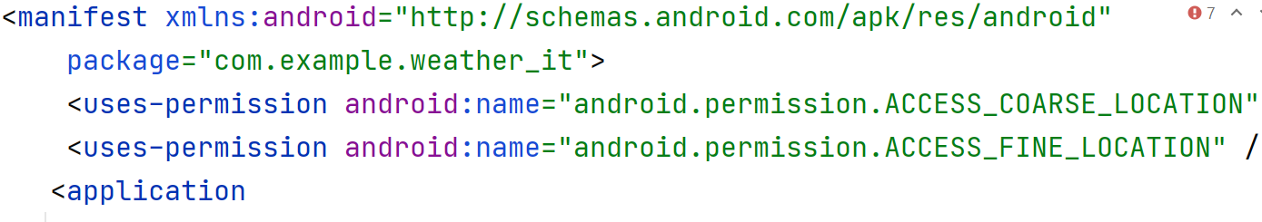
Adding permissions to android manifest
Go to android > app > src > main > AndroidMenifest.xml and add following permissions (like added in below-given picture)
Location Permission
<uses-permission android:name="android.permission.ACCESS_COARSE_LOCATION" />
<uses-permission android:name="android.permission.ACCESS_FINE_LOCATION" />
Internet permission
<uses-permission android:name="android.permission.INTERNET"/>

Slide 6
permission for location services
Checking the permission
LocationPermission permission = await Geolocator.checkPermission();
Request the permission
LocationPermission permission = await Geolocator.requestPermission();

Slide 7
Geo location must be async
void getLocation() async{ Position position = await Geolocator.getCurrentPosition( desiredAccuracy: LocationAccuracy.high); }

Slide 8
Code to get current location
void getcurrentPos() async {
Permissions = await Geolocator.checkPermission();
if (Permissions == LocationPermission.denied) {
Permissions = Geolocator.requestPermission();
if (Permissions == LocationPermission.denied) {
print("permission denied");
}
}
Position position = await Geolocator.getCurrentPosition(
desiredAccuracy: LocationAccuracy.high);
print(position.latitude);
print(position.longitude);
}

Slide 9
Asynchronous programming: futures, async, await
Asynchronous operations let your program complete work while waiting for another operation to finish.
void example() async {
await …
}
Future
A future (lower case “f”) is an instance of the Future (capitalized “F”) class.
A future represents the result of an asynchronous operation, and can have two states: uncompleted or completed.

Slide 10
Asynchronous programming: futures, async, await
Future<void> printOrderMessage() async {
print('Awaiting user order...');
var order = await fetchUserOrder();
print('Your order is: $order');
}

Slide 11
internal state for a StatefulWidget
State is information that
can be read synchronously when the widget is built
might change during the lifetime of the widget.
State objects have the different lifecycle
State class - widgets library - Dart API (flutter.dev)

Slide 12
internal state for a StatefulWidget
initState() → void
Called when this object is inserted into the tree
activate() → void
Called when this object is reinserted into the tree after having been removed via deactivate
build(BuildContext context) → Widget
Describes the part of the user interface represented by this widget, set stae method call
deactivate() → void
Called when this object is removed from the tree
dispose() → void
Called when this object is removed from the tree permanently

Slide 13
APIs

Slide 14

API (Application Program Interface)
An API is a set of routines, protocols, and tools for building software applications.
You must have API Keys.

Slide 15
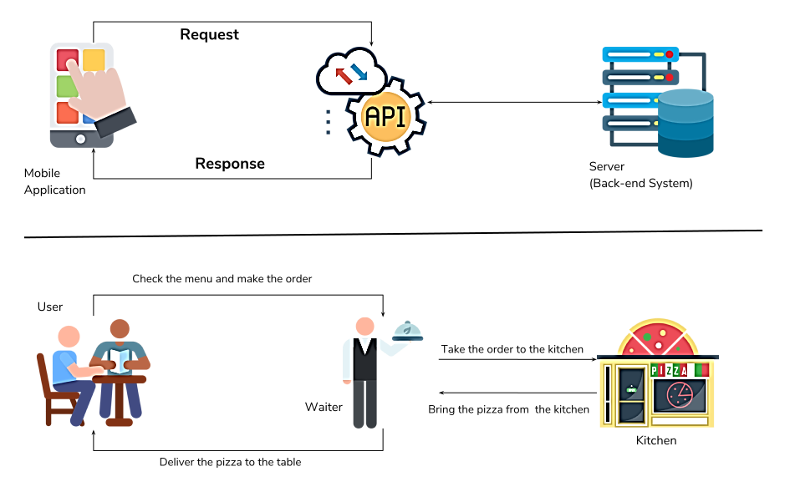
API

Slide 16
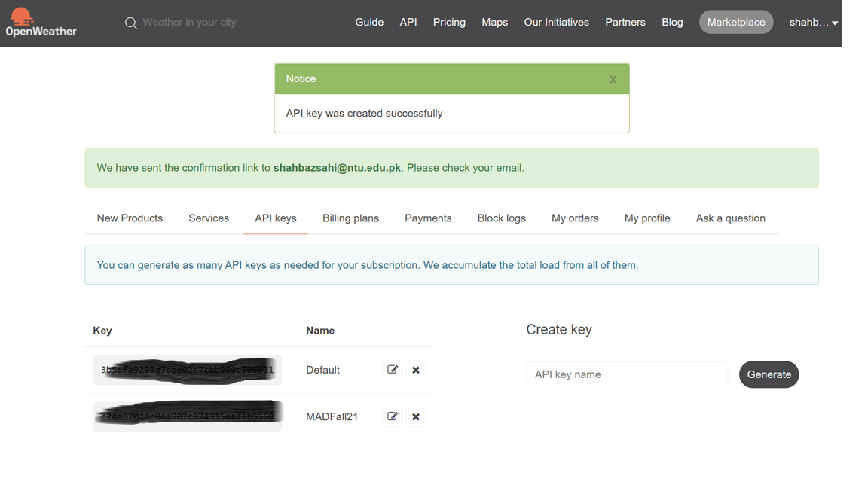
Get weather API Key
Go to Weather API – OpenWeatherMap and create get API key.

Slide 17
Using http package
A composable, Future-based library for making HTTP requests.
This package contains a set of high-level functions and classes that make it easy to consume HTTP resources.
Installing
dependencies:
http: ^0.13.4
import 'package:http/http.dart’ as http;
http | Dart Package (pub.dev)
Fetch data from the internet | Flutter

Slide 18
Using http package - Make a network request
Future<http.Response> fetchWeather() async {
return await http.get(Uri.parse(' api.openweathermap.org/data/2.5/weather?q={city name}&appid={API_key}'));
}
The http.Response class contains the data received from a successful http call.

Slide 19
Getting the response code and body
Get the response body
response.body
Get the resoonse code
response.statusCode

Slide 20
HTTP response codes
Informational responses (100–199)
Successful responses (200–299)
Redirection messages (300–399)
Client error responses (400–499)
Server error responses (500–599)

Slide 21
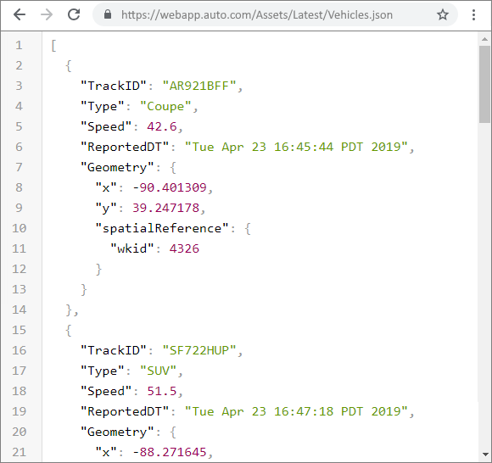
JSON (JavaScript Object Notation)
'{"name":"John", "age":30, "car":null}'
It defines an object with 3 properties:
name
age
car

Slide 22
Parsing the json
Use the dart:convert library
dart:convert library - Dart API
import 'dart:convert’;
Use the jsonDecode function
Parses the string and returns the resulting Json object.
var longitude = jsonDecode(data)[‘coord’][‘lon’];
jsonDecode function - dart:convert library - Dart API

